Slide 1
ADVANCED PROGRAMING PRACTICES
SOEN 6441 - Advanced Programming Practices
Revision Control Systems
CVS in Eclipse
Tortoise CVS
Git
Joey Paquet, 2006-2018

Slide 2
REVISION修订 CONTROL SYSTEMS
SOEN 6441 - Advanced Programming Practices
Joey Paquet, 2006-2018

Slide 3
What is revision control?
SOEN 6441 - Advanced Programming Practices
Revision control is any kind of structured practice that tracks and provides control over changes to files, particularly source code.
As teams design, develop and deploy software, it is common for multiple versions of the same software to be deployed in different sites and for the software developers to be working simultaneously on updates.
This requires a solution to keep track of the different versions, and to manage the incorporation of new changes in the appropriate versions.
Joey Paquet, 2006-2018

Slide 4
Why?
SOEN 6441 - Advanced Programming Practices
Why use a revision control system?
  To have a common repository for all project files available and updated remotely.
  To make sure that concurrent changes to the same file are properly handled.
  To allow the branching of versions in a seamless operation.
  To avoid copying all files when creating a new version of a project.
  To make sure that everybody in a team is always using the correct version of project files.
  To ensure a proper rollback sequence in the event that some changes need to be undone.
  To compare the differences between different file versions (using diff).
  To access previous project versions seamlessly (using version tagging)
Joey Paquet, 2006-2018

Slide 5
Goals
SOEN 6441 - Advanced Programming Practices
Maximizing productivity by automating integration tasks.
Reducing confusion, minimizing mistakes.
Maximizing software integrity, traceability, and programmer accountability.
Assisting developers in providing coordinated changes to software products and components.
Accurately recording the composition of versioned software products evolving into many revisions and variants.
Reconstructing previously recorded software components versions and configurations.
Joey Paquet, 2006-2018

Slide 6
General functioning
SOEN 6441 - Advanced Programming Practices
A repository is created that contains some versions of the files composing a software system.
After creation of the repository, a “snapshot” of the files (e.g. the latest revision) can be retrieved, thus creating a local copy of the files that can be worked upon in isolation from the repository.
When the changes to the local copy are completed to satisfaction, the changes can be committed to the repository, thus creating a new version of the software.
If more than one user is trying to commit changes to the same file, a merge operation has to be performed, which can be semi-automated, but is often non-trivial if extensive changes were applied.
Frequent committing reduces the complexity of merge operations.
Joey Paquet, 2006-2018

Slide 7
Concepts
SOEN 6441 - Advanced Programming Practices
Repository
  This is where a copy of your files and directories are stored. A special file structure is used for tracking the differences between subsequent versions of a file.
Working Copy and Workspace
  This is a copy of a group of files in your local file system (previously pulled from a Repository).
  If the IDE integrates the use of a revision control plugin (e.g. Eclipse or Netbeans CVS or GIT plugin), the Working copy is automatically mapped onto the project workspace.
  If you are using a separate revision control software client (e.g. WinCVS, Tortoise CVS, Git, Sourcetree, etc), you have to map your working copy files into the IDE’s workspace manually.
Commit
  This is the process of saving (or pushing) files to the Repository. You may commit specific files or a whole project to the Repository. Generally, only files that have changed since the last pull are subject to the commit operation.
Checkout
  This is the process of retrieving (or pulling) files from the Repository, i.e. downloading a local copy to your machine.
Joey Paquet, 2006-2018

Slide 8
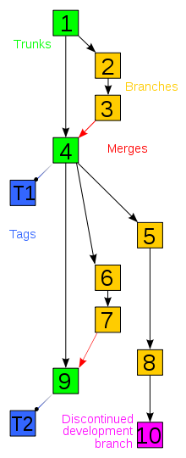
Concepts
SOEN 6441 - Advanced Programming Practices
Trunk, branching and tagged versions
  A branch is a collection of revisions that for some reason should not be committed onto the main trunk of development.
  For example, if we want to work on a part of the code doing changes that we are not going to share until we are not satisfied with the result we could work on our own branch, without disturbing anyone else.
  Branching is a powerful mechanism for controlled isolation.
  The original set of versions, before the branch was created, is called the main line or main branch, or trunk.
  After a branch is created the trunk is still the default version.
  We can always merge changes from a branch into the trunk or vice-versa (though it may be a complex operation).
  At any time, one can tag the current state of revisions to create a tagged version that can be referred to by name or number later.
  By default, commit and checkout operations are applied on the latest tagged version on the trunk.
Joey Paquet, 2006-2018

Slide 9
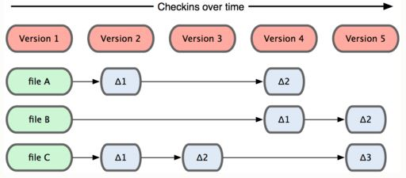
Approaches to store the changes
SOEN 6441 - Advanced Programming Practices
Store individual changes to files (deltas)
Joey Paquet, 2006-2018

Slide 10
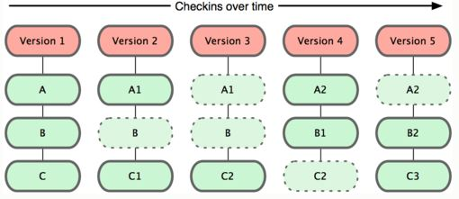
Approaches to store the changes
SOEN 6441 - Advanced Programming Practices
Store entire files as new versions when they are changed
Joey Paquet, 2006-2018

Slide 11
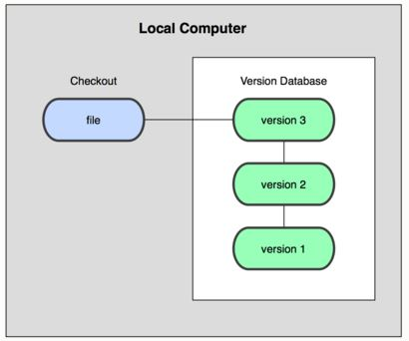
Approaches in repository distribution
SOEN 6441 - Advanced Programming Practices
Local version control systems
  Only a local repository exists that manages the revisions locally
  No remote access
  No concurrent changes
  Normally uses the deltas storage approach
Examples:
  SCCS: Source Code Control System
  RCS: Revision Control System
Joey Paquet, 2006-2018

Slide 12
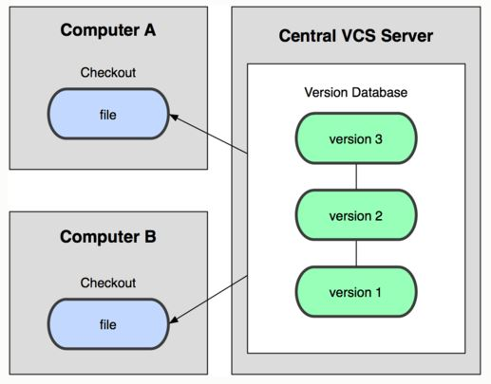
Approaches in repository distribution
SOEN 6441 - Advanced Programming Practices
Centralized repository
  A single server contains all the recorded versions
  Clients can checkout any version remotely
  Many advantages over local revision management
    Distributed revisions
    Teamwork
    Project management
  Disadvantages over distributed repositories
    Single point of failure
    File access concurrency
Examples
  CVS: Concurrent Versioning System
  Apache Subversion (SVN)
  Perforce
Joey Paquet, 2006-2018

Slide 13
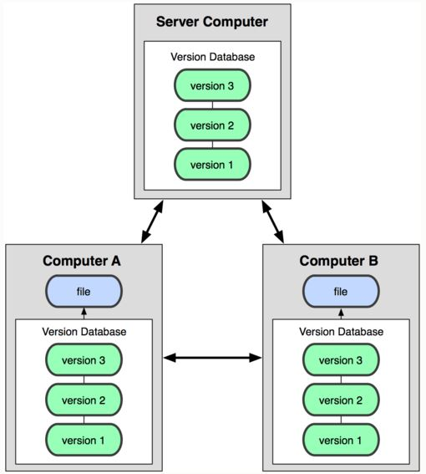
Approaches in repository distribution
SOEN 6441 - Advanced Programming Practices
Distributed repository
  A server contains all the recorded versions
  Any client can then act as a server
  Clients can checkout any version remotely from any server
  Many advantages over centralized repository
    No single point of failure
    Teamwork with individual initiatives/storage
    Project management
  Popular in the free software movement
Examples:
  Git, Mercurial, GNU Bazaar or Darcs
Joey Paquet, 2006-2018

Slide 14
ECLIPSE CVS PLUGIN
SOEN 6441 - Advanced Programming Practices
Joey Paquet, 2006-2018

Slide 15

Creating a new CVS repository
SOEN 6441 - Advanced Programming Practices
The Eclipse IDE is based on the notion of plugin.
Plugins are additional tools that you can install in your IDE.
There is a CVS client Eclipse plugin that provides a seamless integration of CVS revision control into the Eclipse environment.
Before you can use the Eclipse CVS plugin (or any other CVS client), you must already have a CVS repository to connect to.
To create a new CVS repository, login to a Unix machine (e.g. login.encs.concordia.ca) and use the following command
cvs -d fullfoldername init
The folder name must be a full folder name, i.e. starting from the root of the file system.
Make sure that this folder has proper access rights to allow any team member to access it remotely.
Joey Paquet, 2006-2018

Slide 16
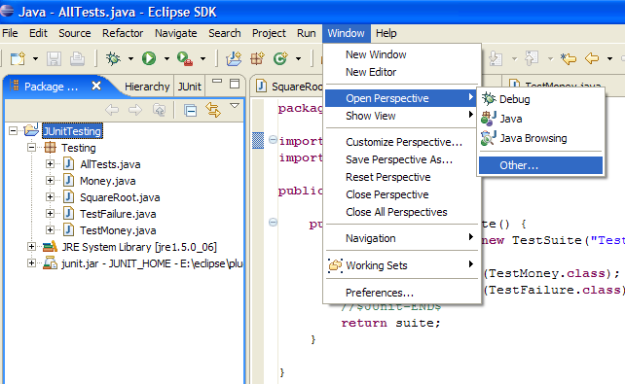
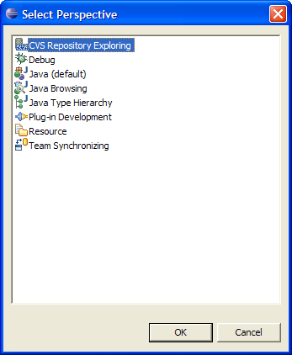
Setting up Eclipse for CVS
SOEN 6441 - Advanced Programming Practices
First, you should enable the Eclipse perspective for CVS.
  From Window menu: [Window>Open Perspective>Other …]
  From the Select Perspective window pick up CVS Repository Exploring.
Second, you should show the CVS Repositories view.
  From Window menu: [Window>Show View>CVS Repositories]
Joey Paquet, 2006-2018

Slide 17
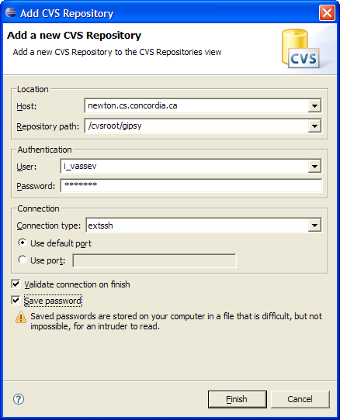
Setting up Eclipse for CVS
SOEN 6441 - Advanced Programming Practices
Next, you should connect to an existing CVS Repository.
Right mouse click in the CVS Repositories window.
From the right mouse click menu select
[New → Repository Location ...]
Complete the Add CVS Repository dialog as shown.
Location Host: login.encs.concordia.ca
Repository path: enter the full path of the cvs repository (i.e. the fullfoldername used on the previous slide)
Connection Type: extssh
Joey Paquet, 2006-2018

Slide 18
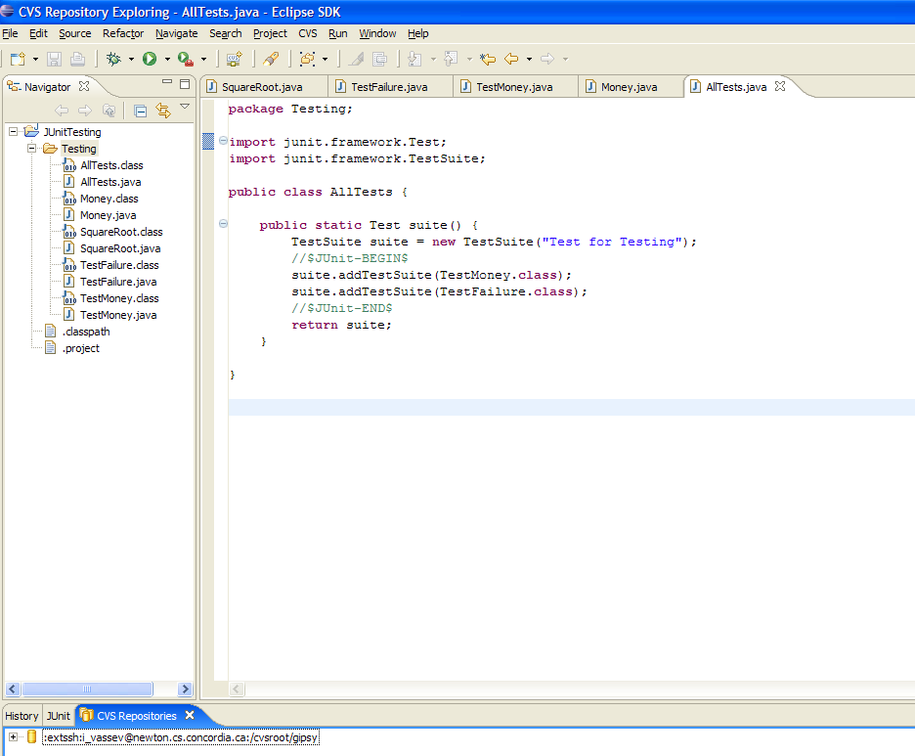
Setting up Eclipse for CVS
SOEN 6441 - Advanced Programming Practices
After validation, CVS Repositories window in Eclipse will show the connected repository.
You can have multiple repositories.
Joey Paquet, 2006-2018

Slide 19
Pushing a new workspace into a CVS repository
SOEN 6441 - Advanced Programming Practices
Select the project in the Navigator or other view.
Right click [Context Menu>Team>Share Project...]
Follow the wizard for identifying your repository location and and repository module name.
The Synchronize view opens, showing all your outgoing changes.
Select the project in the Synchronize view.
Right click [Context Menu>Commit].
Answer yes when prompted to add new files to version control.
Supply a release comment if you like.
The project now exists in the repository.
Joey Paquet, 2006-2018

Slide 20
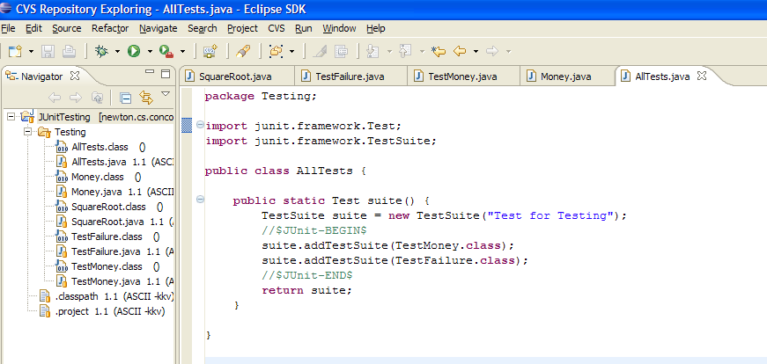
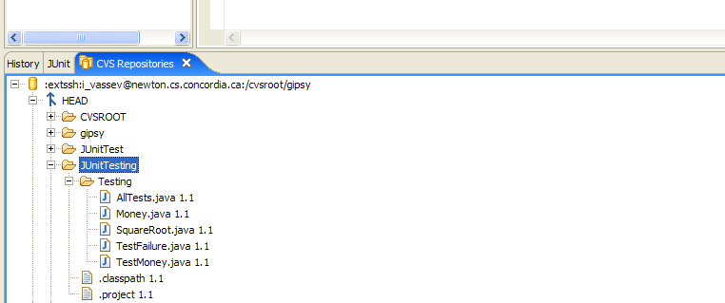
Pushing a new workspace into a CVS repository
SOEN 6441 - Advanced Programming Practices
Right mouse click in the CVS Repositories view and select Refresh View to see your project in the repository.
Joey Paquet, 2006-2018

Slide 21
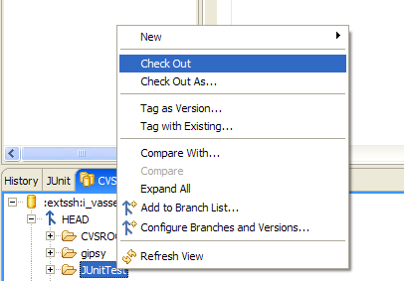
Getting a project from a CVS repository
SOEN 6441 - Advanced Programming Practices
Select [Window>Show View>Other]
Select [CVS>CVS Repositories]
Right click [Context Menu>New>Repository Location...]
Fill in the location information identifying your repository and click Finish.
Expand the newly-created repository location.
Find the module you are interested in.
Right click [Context Menu>Check Out]
Joey Paquet, 2006-2018

Slide 22
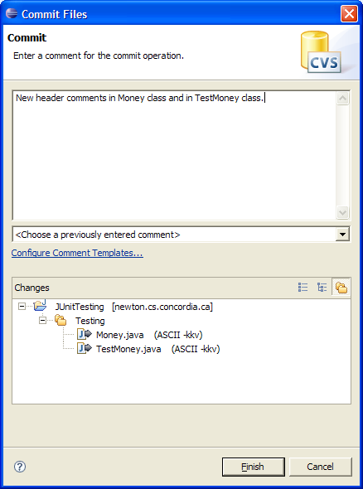
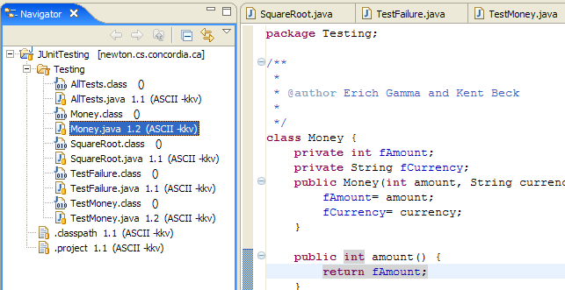
Committing changes
SOEN 6441 - Advanced Programming Practices
If you have changed some of your source files and wish to commit those changes in your files that are in the CVS repository, you do the following:
From the Java Perspective (or other similar perspective), right mouse click on the project and select [Team>Commit... ]
Enter a comment in the Commit dialog and press Finish.
New version for modified files
Joey Paquet, 2006-2018

Slide 23
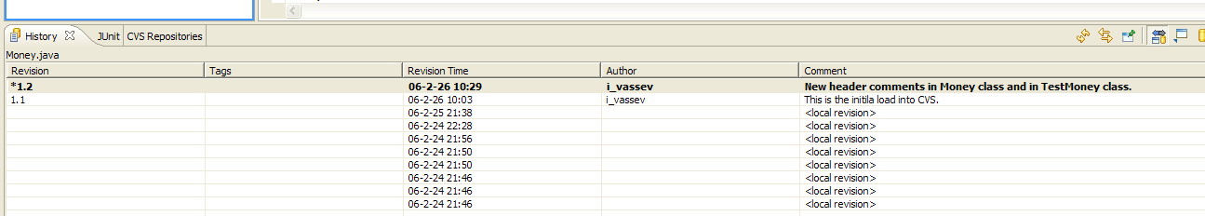
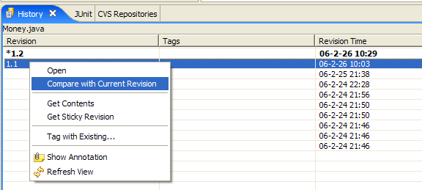
History and comparison
SOEN 6441 - Advanced Programming Practices
From the Java Perspective (or other similar perspective), right mouse click on the changed file and select [Team>Show Resource History]
The version history appears in the History Window.
Select the version you wish to compare with the current one.
Right mouse click and select Compare with Current Revision.
Joey Paquet, 2006-2018

Slide 24
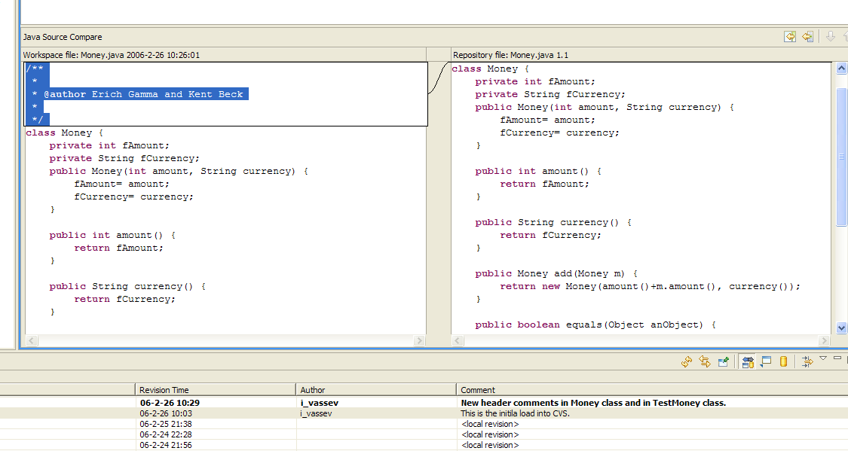
History and comparison
SOEN 6441 - Advanced Programming Practices
Java Source Compare window shows up both file versions and highlights the differences.
Joey Paquet, 2006-2018

Slide 25
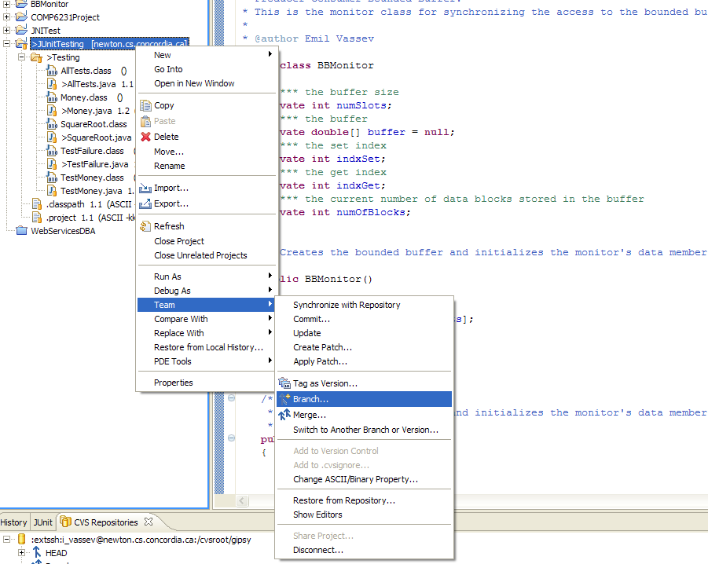
Branching
SOEN 6441 - Advanced Programming Practices
If you want to create an independent branch on which to work, right-click on the project name and select [Team>Branch].
Joey Paquet, 2006-2018

Slide 26
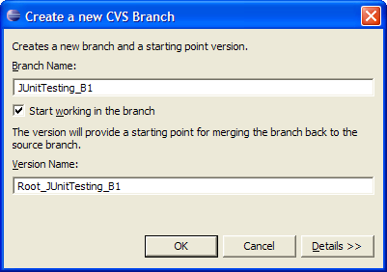
Branching
SOEN 6441 - Advanced Programming Practices
A Create Branch dialog box is displayed.
Enter a branch name
Leave the check box checked for Start working in the branch.
Notice that a version name is also automatically filled created
You may choose a different name (so long as it doesn't conflict with an existing CVS tag). It will be used later by the merge editor to determine what has changed since branch creation.
Click OK.
Joey Paquet, 2006-2018

Slide 27
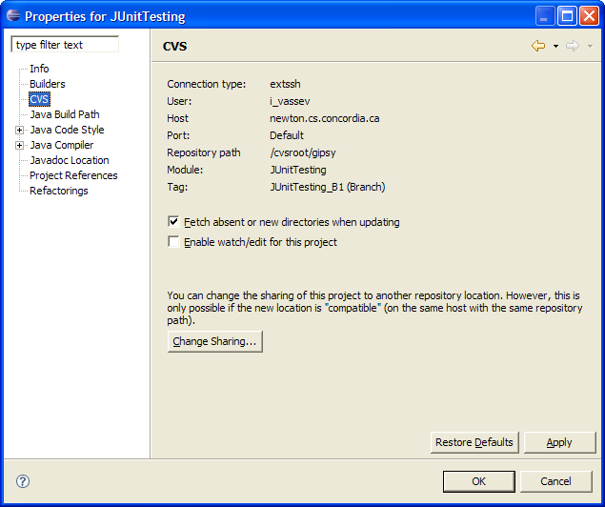
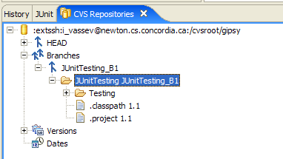
Branching
SOEN 6441 - Advanced Programming Practices
You should be able to see the result of your branch in two ways:
  By right-clicking the project and selecting Properties and then CVS, you should see your branch in the Tag field.
  In the CVS Repositories view expand the Branches node.
Joey Paquet, 2006-2018

Slide 28
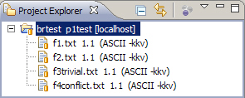
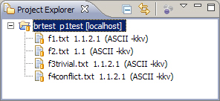
Branching and merging
SOEN 6441 - Advanced Programming Practices
Suppose that you started with the following files in your project after the branching (project brtest, branch p1test)
And you apply a change to files f1.txt and f3trivial.txt, and then commit. You will get the following result:
Note the version numbers now use four digits instead on two due to the branching.
If you want to merge your branch into the main trunk, you have to tag a version on this branch by right-click the project and select [Team >Tag as Version...]
Merging problems happen when, for example, someone would commit changes to the main trunk as changes to the branch are also made on the same files.
Joey Paquet, 2006-2018

Slide 29
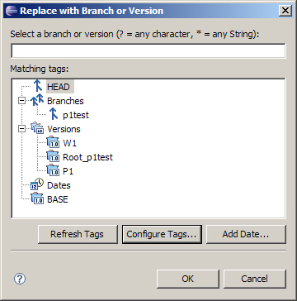
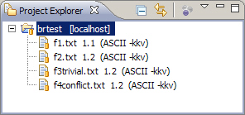
Merging
SOEN 6441 - Advanced Programming Practices
The first step of a merge is to point the workspace to the target branch. In our case, the target of the merge is the main trunk.
To switch the project contents to that of the main branch, right-click on your project in the Navigator view and select [Replace With>Another Branch or Version].
You should see a branch selection similar to the one on the right, which contains branches and tagged versions.
After having switched to the main trunk, you can observe that the version numbers are back to two digits, i.e. you have left the branch and are back on the main trunk.
Joey Paquet, 2006-2018

Slide 30
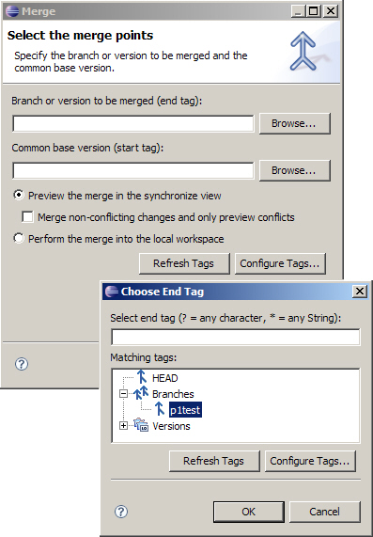
Merging
SOEN 6441 - Advanced Programming Practices
The next step is to specify what branch you want to merge with your current branch (in this case the main trunk).
Right-click on the project and select [Team → Merge ....] Click the Browse button next to the Branch or version to be merged field. Choose the branch from the Choose End Tag dialog box. If you don't see the branch, you may have to click Refresh tags.
Check the Merge non-conflicting changes checkbox to automatically apply non-conflicting merges.
The difficult part comes when two files have had changes applied to the same lines of code, for which manual decisions have to be made.
Joey Paquet, 2006-2018

Slide 31
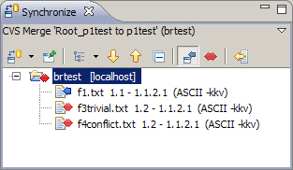
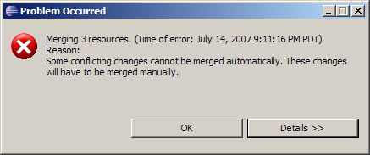
Merging
SOEN 6441 - Advanced Programming Practices
Once you have chosen the branch to be merged, the system looks for differences between the files in the two versions and will report on files having differences.
Right click on the project and select Merge to start the merge operation
The system then applies all non-conflicting merges and reports an error if conflicting merges are present.
Joey Paquet, 2006-2018

Slide 32
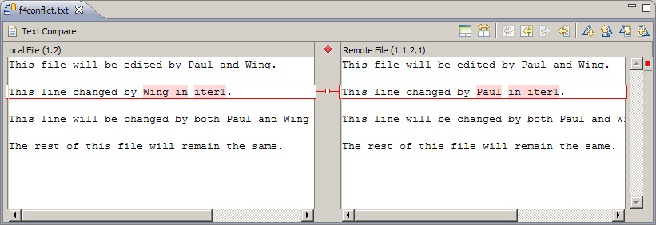
Merging
SOEN 6441 - Advanced Programming Practices
To resolve the conflicting merges (presented with a red double-arrow), double-click the file in question.
The conflicting changes are highlighted in red. Figure out what the resulting change should be, make the change in the main trunk files, right-click in the editor window of this file and select Save.
After all conflicts have been resolves and saved, select the project in the Navigator view and select [Team>Synchronize with Repository], then commit the change by right-clicking the project folder and selecting Commit.
Normally, you also want to create a tagged version after a merge operation.
Joey Paquet, 2006-2018

Slide 33
TORTOISE CVS CLIENT
SOEN 6441 - Advanced Programming Practices
Joey Paquet, 2006-2018

Slide 34

TortoiseCVS – Introduction, creating a new CVS repository
SOEN 6441 - Advanced Programming Practices
TortoiseCVS is a CVS client developed for Windows.
It is release under the GNU General Public License.
It conveniently integrates itself with the Windows file explorer.
Like for any other CVS client, before you can use the Tortoise CVS client, you must already have a CVS repository to connect to.
To create a new CVS repository, login to a Unix machine (e.g. login.encs.concordia.ca) and use the following command
cvs -d fullfoldername init
The folder name must be a full folder name, i.e. starting from the root of the file system.
Make sure that this folder has proper access rights to allow any team member to access it remotely.
Joey Paquet, 2006-2018

Slide 35
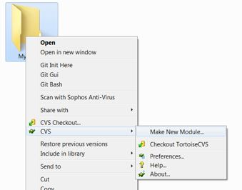
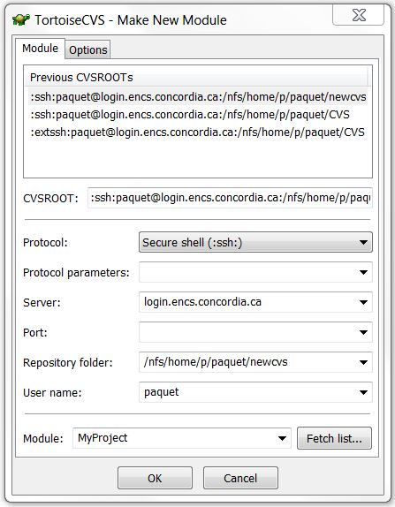
TortoiseCVS - Creating a new CVS module
SOEN 6441 - Advanced Programming Practices
Next, you have to create a new CVS module, which is a folder that contains all the files you will manage.
First create a folder, then right click on it and select [CVS>Make New Module…]
Use ssh connection to connect to the machine on which the CVS repository was created, and specify in what folder your CVS repository resides.
Joey Paquet, 2006-2018

Slide 36
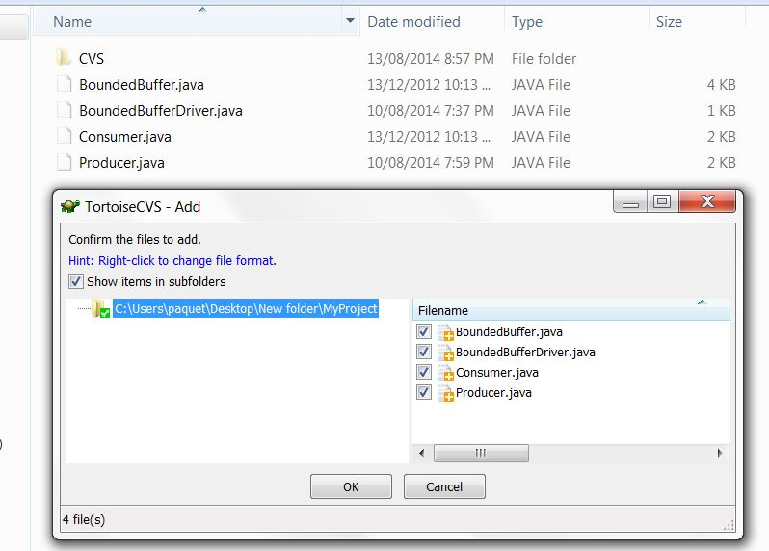
TortoiseCVS - Add content and commit to the repository
SOEN 6441 - Advanced Programming Practices
Create some files to be committed, put them in your project folder.
Right-click in the folder window and select CVS Add Contents…
Check the files that you want to add to the repository, click OK. You will then be asked to enter your password.
To commit your files, right click in you folder window and select CVS Commit
Joey Paquet, 2006-2018

Slide 37
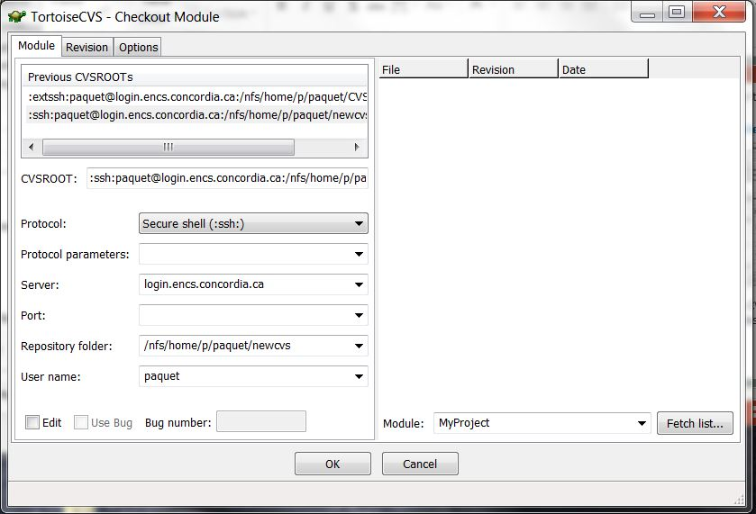
TortoiseCVS - Retrieve a local copy from a CVS repository
SOEN 6441 - Advanced Programming Practices
To retrieve the latest revision of the main trunk of a project from a CVS repository, right click in any folder (e.g. the desktop) and select [CVS>Checkout]
Fill in the credentials for the previously created CVS repository and click OK.
If you want a different branch or version than the latest revision of the main trunk, use the Revision tab.
Joey Paquet, 2006-2018

Slide 38
TortoiseCVS - Adding files to your IDE
SOEN 6441 - Advanced Programming Practices
Some IDEs have integrated support for CVS, such as Eclipse and Netbeans.
Most will require the installation of a ready-made plugin or other external modules.
Other IDEs, such as Visual Studio, don’t have embedded CVS support, or for some reason you may want to use your own CVS client as a separate tool. In this case:
  Use the CVS client to checkout into a folder.
  Once you have your files in the checkout folder, use your IDE’s features to import the files from the folder to your project. You generally have to copy the files into your workspace folder prior to that..
  For convenience, you may want to create the new CVS module after the IDE project is created and use the project’s folder name as the name of the new CVS module. This way, you don’t have to move your files around after you checkout.
In either case, the initial CVS repository needs to be created manually.
Joey Paquet, 2006-2018

Slide 39
GIT
SOEN 6441 - Advanced Programming Practices
Joey Paquet, 2006-2018

Slide 40

Git - Introduction
SOEN 6441 - Advanced Programming Practices
Git as an open-source distributed revision control system.
Developed by Linus Torvalds during the development of Linux.
It is extensively used by free software development communities.
Many studies show that Git has become the most popular revision control system, and that many companies are making it a mandatory requirement in job postings.
It is available on Unix/Linux, Windows and OS X under the GNU General Public License.
Joey Paquet, 2006-2018

Slide 41
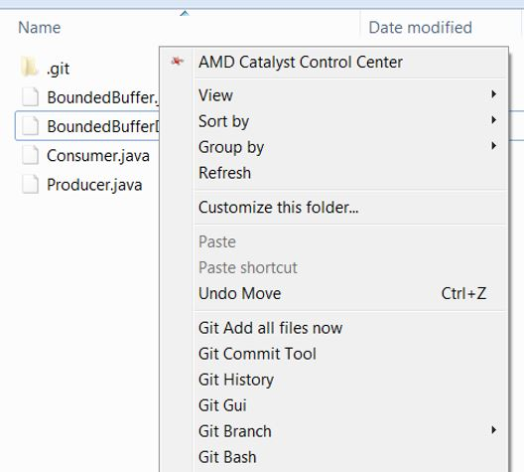
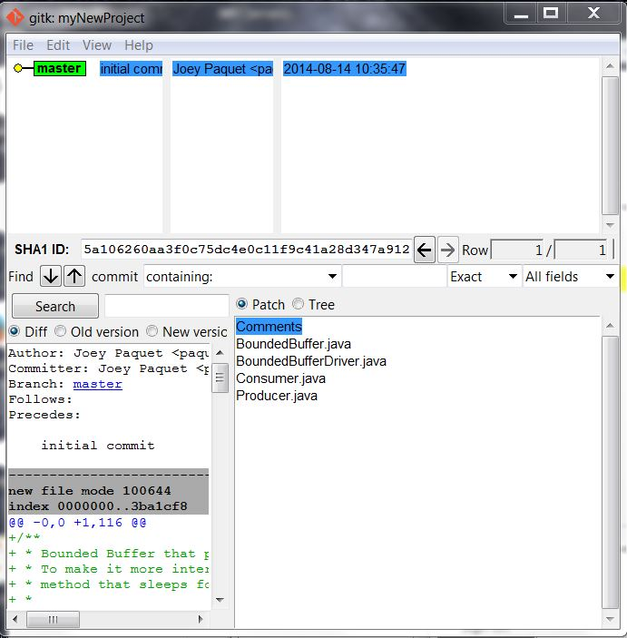
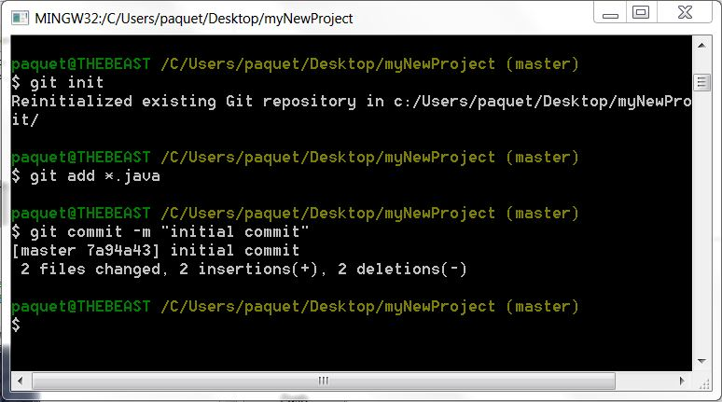
Git – Installed features
SOEN 6441 - Advanced Programming Practices
It provides a GUI tool to do all revision control operations, as well as visualizing the revision history tree.
On Windows, it provides with contextual menu add-ons that enable to do various operations, as well as a Unix shell.
Joey Paquet, 2006-2018

Slide 42
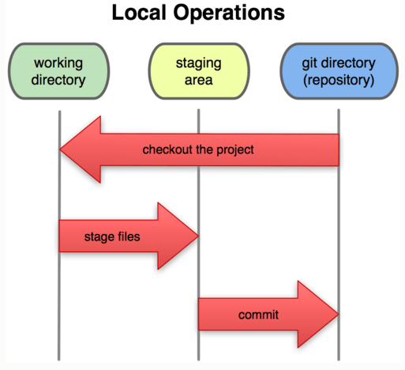
Git – creating a new local Git repository
SOEN 6441 - Advanced Programming Practices
Git is a distributed revision control system.
Any Git repository you create can potentially be used either as a server or as a client.
A Git repository is a folder in which there is a .git folder that is used to manage the revisions on the content of the files in your folder.
To create a local Git repository, simply open the folder and either use the Git GUI or the Git shell to issue a git init command, which creates a new Git repository in this folder.
Then you may put some files in this folder and issue a git add command to put these files in the staging area.
To commit these files to your local repository, use the git commit command.
If your machine/folder is accessible via ssh, you may then connect to this repository from another Git repository.
Joey Paquet, 2006-2018

Slide 43
Git – getting and updating a project from a remote repository
SOEN 6441 - Advanced Programming Practices
Before you connect to a remote repository to get a new fresh project, you must first create an empty Git repository using the git init command.
If you want to get a full copy of the whole repository from a remote Git repository, use the clone command:
  git clone username@machine:/fullpathofrepository
You may also want to create remotes, which are aliases for the Git repositories that you are using. For example, if you cloned the repository as above, Git automatically create a remote called origin during the clone operation.
You may use the git remote add command to add a remote:
  git remote add remotename username@machine:/fullpathofrepository
To print the list of remotes available, use the git remote –v command.
Once you have a populated copy of a repository, if you want to refresh your copy (supposing that the remote copy was further updated after your last pull), use the git fetch command:
  git fetch remotename
If your local repository was previously cloned as above, you can use:
  git fetch origin
Joey Paquet, 2006-2018

Slide 44
Pushing a newly created Git repository
SOEN 6441 - Advanced Programming Practices
Create a Git repository on the remote machine:
  ssh user@example.com
  mkdir my_project.git
  cd my_project.git
  git init –bare
Push a Git repository from the local machine to the remote machine:
  cd my_project
  git init
  git add *
  git commit -m "My initial commit message"
  git remote add origin user@example.com:my_project.git
  git push -u origin master
Joey Paquet, 2006-2018

Slide 45
References
SOEN 6441 - Advanced Programming Practices
Scott Chacon. Pro Git. First Edition. Apress. 2009. ISBN-13: 978-1430218333
http://git-scm.com/docs
http://git-scm.com/book
http://en.wikipedia.org/wiki/Comparison_of_revision_control_software
http://www.eclipse.org/articles/article.php?file=Article-BranchingWithEclipseAndCVS/article1.html
http://git-scm.com/
http://wiki.eclipse.org/index.php/CVS_FAQ
http://www.tortoisecvs.org/
Joey Paquet, 2006-2018

